Slide 1
LIBRARY INFORMATION SYSTEM
BY:
20PW03, 20PW19, 20PW32, 20PW35, 20PW36

Slide 2
PROBLEM STATEMENT
The University library system will record the books owned by the library as well as any new books
purchased and put into circulation. Before someone can borrow a book, he or she must show a
valid ID card that is checked – to ensure that it is still valid – against the student files maintained by
the registrar’s office (for student borrowers), the faculty/staff files maintained by the personnel
office (for faculty/staff borrowers), or the library’s own guest file (for individuals issued a guest card
by the library). The system must also check to ensure the borrower does not have any overdue
books or unpaid fines before he or she can borrow another book. If no fines or overdue books are
found, the book is checked out. The system should record who has borrowed what book and when
it is due back. The borrower is also told the due date. Books can only be checked out for two
weeks. When a book is overdue, the information about the book and the person who checked it out
is added to an overdue file. Every Monday, the library prints and mails postcards to those people
with overdue books. If a book is overdue by more than one month, a fine will be imposed and a
librarian will telephone the borrower to remind him or her to return the book.

Slide 3
ITEMS DESIGN
ALBRECHT’S APPROACH
External inputs: Student ID card, Faculty ID card, Guest card, Student Data, Faculty Data, Guest Data, Book request info, Book return details.
External outputs: Fine amount, Due date, ID validation, Mail postcards, calls to borrowers (for reminder), Issue of requested books
External inquiries: Book availability, validation
External files: None
Internal files: Registrar’s Office, Personnel Office, Library guest file, Book maintenance, Overdue File

Slide 4
WEIGHTING FACTOR
External inputs: Student ID card, Faculty ID card, Guest card, Student Data, Faculty Data, Guest Data, Book request info, Book return details.
External outputs: Fine amount, Due date, ID validation, Mail postcards, calls to borrowers (for reminder), Issue of requested books
External inquiries: Book availability, validation
External files: None
Internal files: Registrar’s Office, Personnel Office, Library guest file, Book maintenance, Overdue File

Slide 5
UNADJUSTED FUNCTION POINT COUNT
ITEMS | SIMPLE | AVERAGE | COMPLEX
 | (QUANTITY * WEIGHTING FACTOR)
EXTERNAL INPUTS | 3 * 3 | 4 * 4 | 1 * 6
EXTERNAL OUTPUTS | 2 * 4 | 1 * 5 | 3 * 7
EXTERNAL INQUIRIES | 0 * 3 | 2 * 4 | 0 * 6
EXTERNAL FILES | 0 * 7 | 0 * 10 | 0 * 15
INTERNAL FILES | 0 * 5 | 5 * 7 | 0 * 10
UFC = 9 + 16 + 6 + 8 + 5 + 21 + 8 + 35 = 108

Slide 6
TECHNICAL COMPLEXITY FACTOR
F1 : Reliable backup and Recovery : 5
F2 : Data Communications : 0
F3 : Distributed functions : 0
F4 : Performance : 5
F5 : Heavily used configuration : 0
F6 : Online Data entry : 5
F7 : Operational Ease : 3
F8 : Online Update : 3
F9 : Complex interface : 0
F10 : Complex processing : 3
F11 : Reusability : 0
F12 : Installation ease : 3
F13 : Multiple Sites : 0
F14 : Facilitate change : 3
14
TCF = 0.65 + 0.01 Σ F_{i} = 0.65 + 0.01 (30) = 0.95
i=1

Slide 7
ADJUSTED FUNCTION POINT COUNT
FP = Unadjusted function point count (UFC) X Technical complexity factor (TCF)
UCF = 108
TCF = 0.95
THEREFORE,
FP = 108 x 0.95
= 102.6 FUNCTION POINTS

Slide 8
PROCESS MODEL
Library Information System will be a V-Process Model.
Validation is very important in this system.
System Data is huge

Slide 9
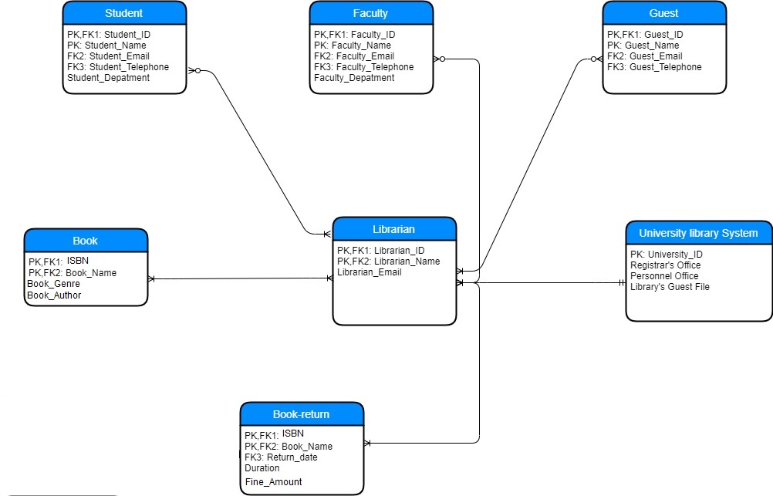
DATABASE DESIGN

Slide 10
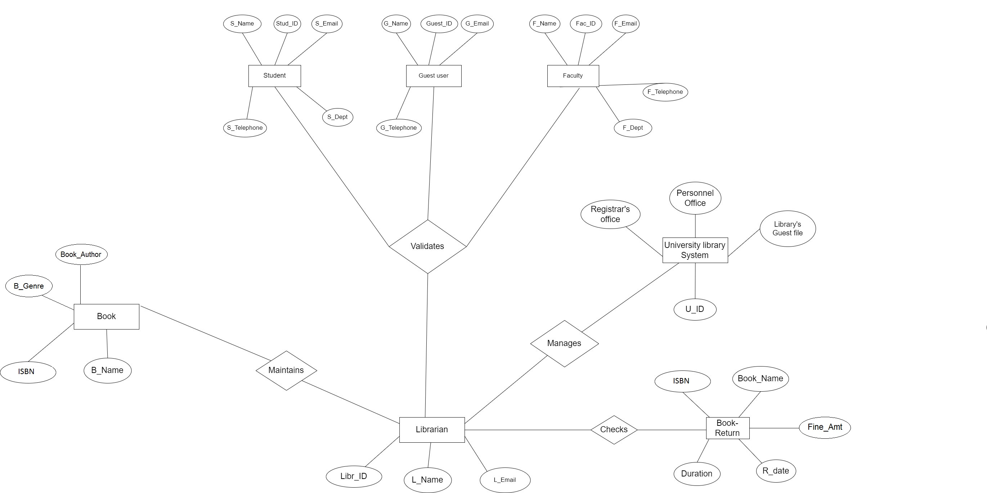
ER DIAGRAM

Slide 11
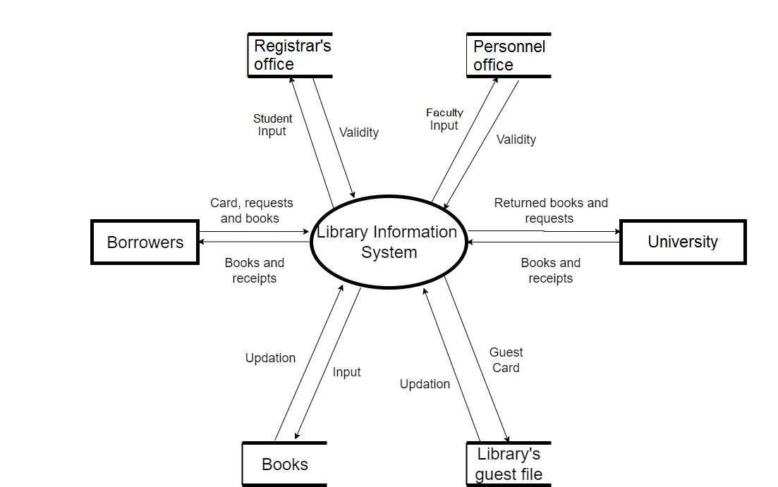
LEVEL 0 DFD

Slide 12
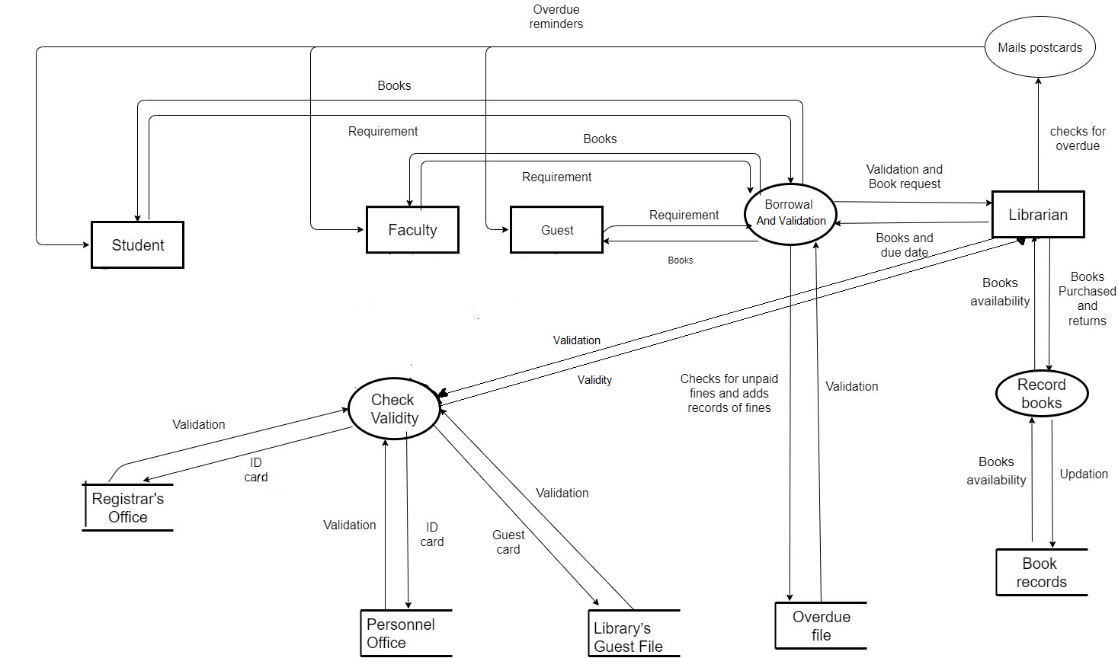
LEVEL 2 DFD

Slide 13
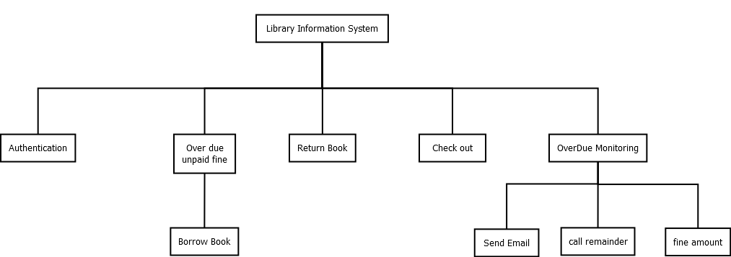
HIPO DIAGRAM

Slide 14
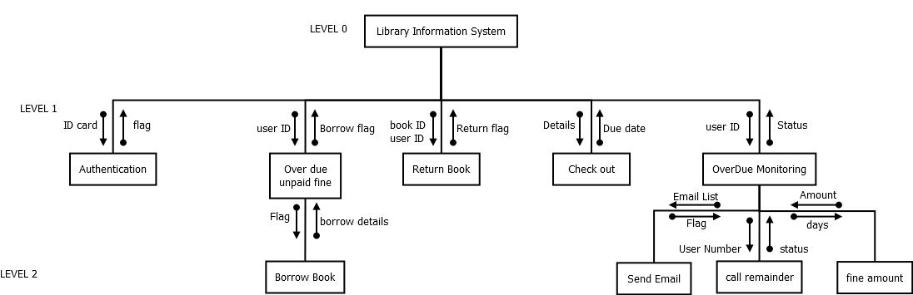
STRUCTURE CHART

Slide 15
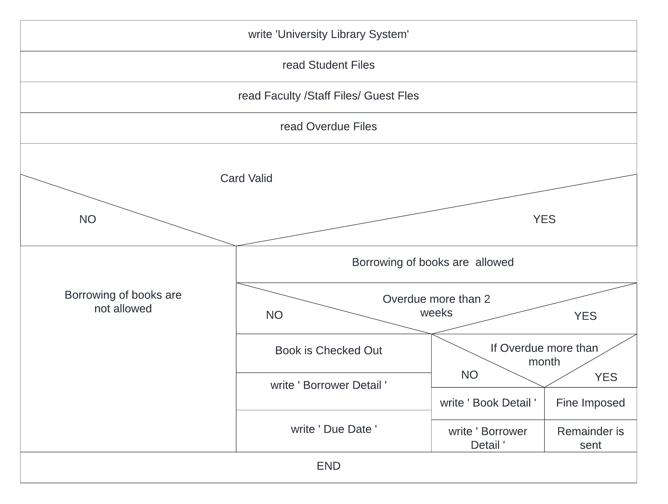
NASSI SHNEIDERMAN DIAGRAM

Slide 16
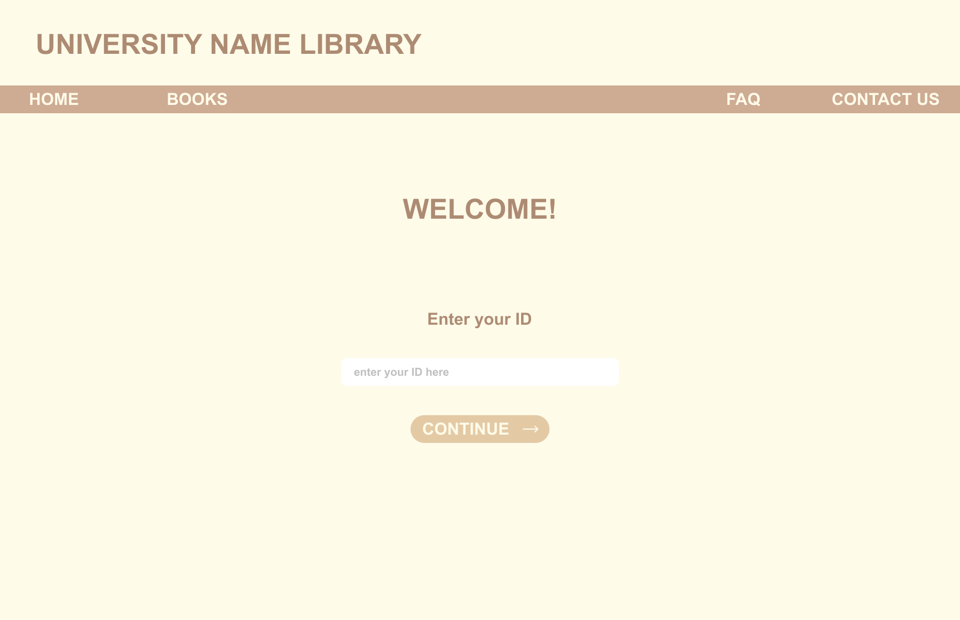
UI DESIGN

Slide 17
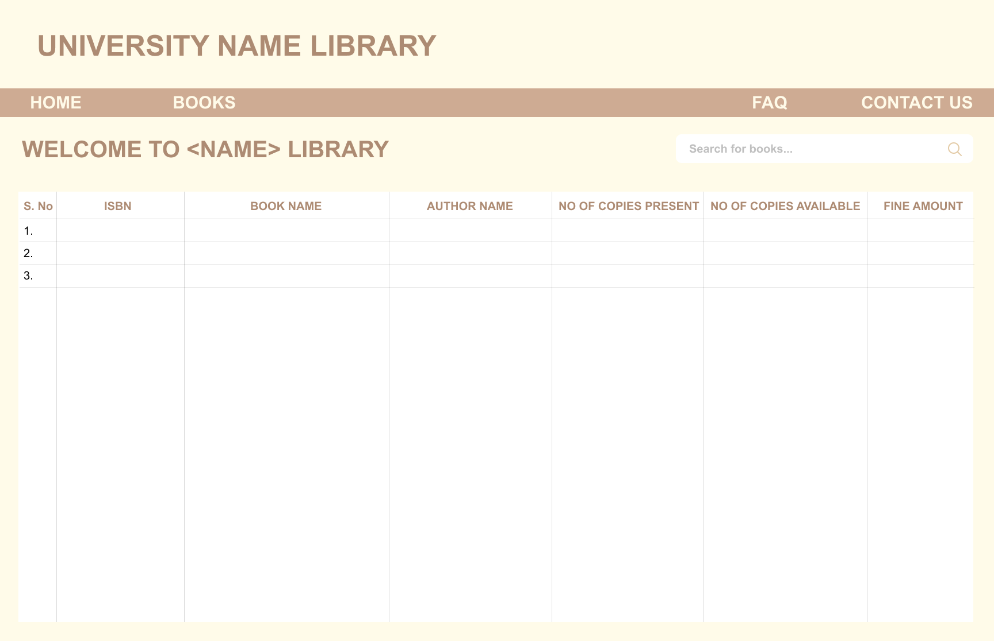
UI DESIGN

Slide 18
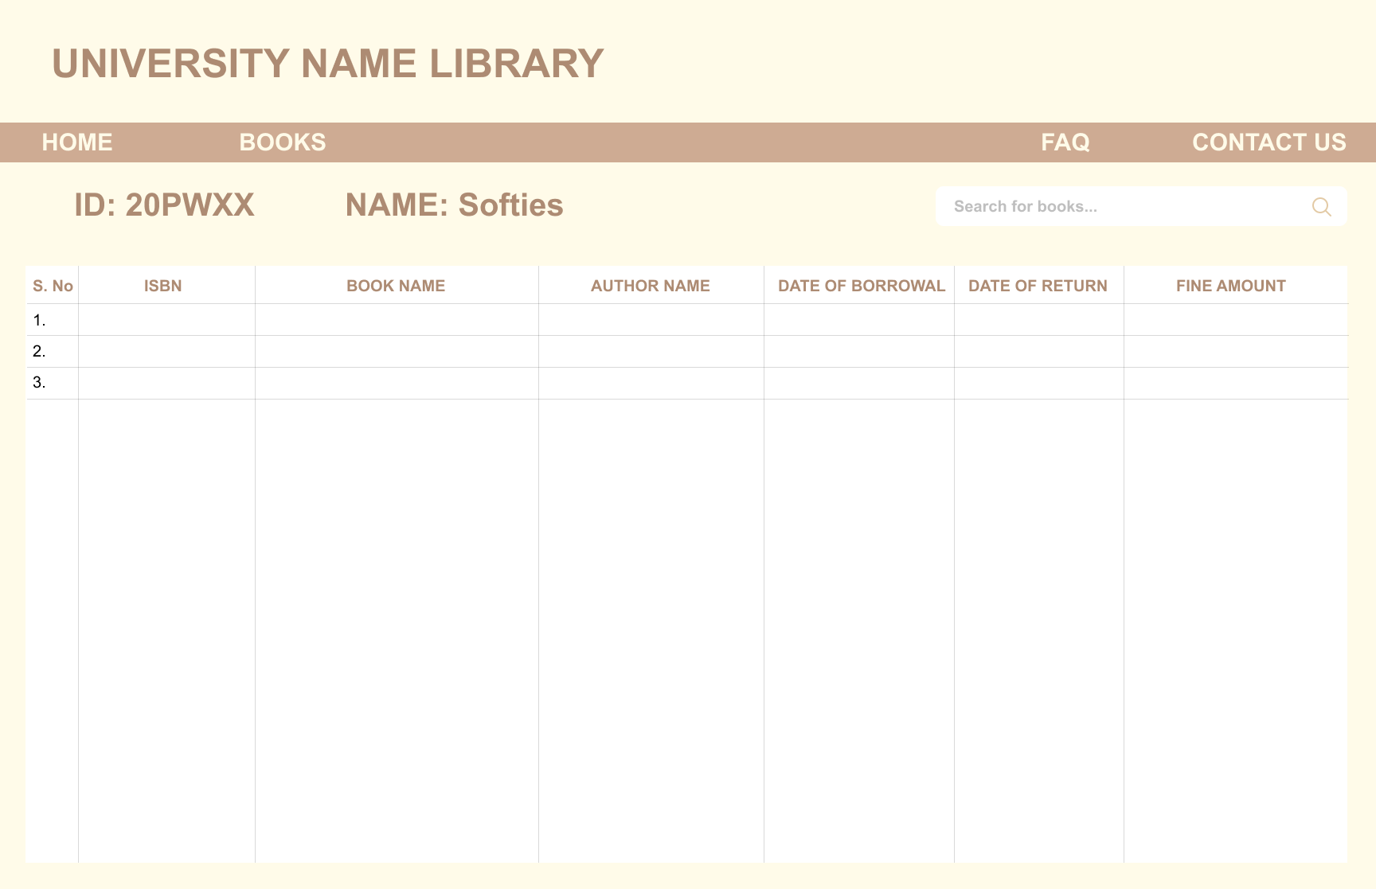
UI DESIGN

Slide 19
THANK YOU

